Slide 1
数据分析与统计软件

Slide 2
Welcome Aboard!
Instructor: Minya Xu (徐敏亚)
Phone: 62756274
Email: minyaxu@gsm.pku.edu.cn
Office: Room 365, Guanghua Building No. 2
助教：杨光艺
Phone: 18811782969
Email: 1401211867@pku.edu.cn

Slide 3
Learning goals
Introduce generalized linear models.
Provide a unifying framework for many commonly used statistical techniques and illustrate the ideas of statistical modelling.
Students are assumed to have some familiarity with statistical principles and methods. In particular, understanding the concepts of estimation, sampling distributions and hypothesis testing is necessary.

Slide 4
学习方式
上课和上机为主。
分小组，共同完成一个项目研究。
研究要求：（1）背景介绍； （2）实际数据；（3）实践上次课程学习的广义线性方法；（4）完成WORD报告；（5）课堂PPT展示研究成果。
成绩评定办法
期末考试，占总分40%。
组成小组完成一个项目研究，占总分60%。30%来自项目研究报告的presentation，30%来自组内成员的打分。

Slide 5
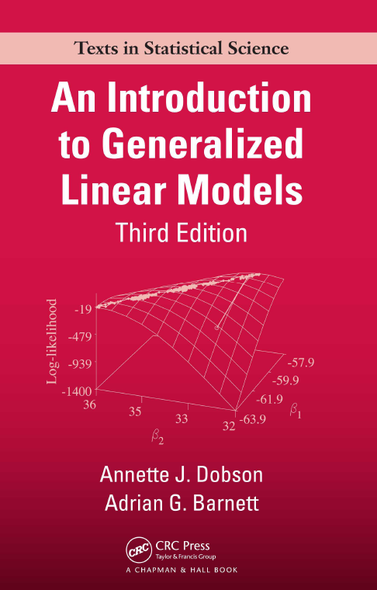
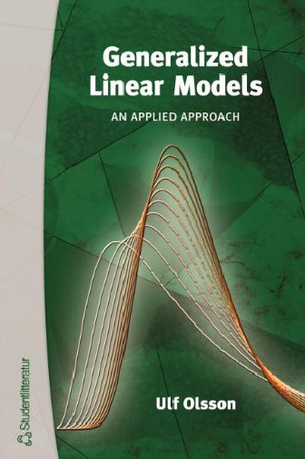
教材
Dobson, A. J., & Barnett, A. (2008).
An introduction to generalized linear models.
CRC press.
Olsson, U. (2002).
Generalized linear models. An applied approach.
Studentlitteratur, Lund, 18.

Slide 6
课程内容
课堂编号 | 讨论的问题
1 | 线性回归
2 | 方差分析
3 | 上机
4 | 0-1回归
5 | 上机
6 | 定序回归 + project presentation
7 | 上机 + project presentation
8 | 泊松回归 + project presentation
9 | 上机 + project presentation
10 | 生存数据分析 + project presentation
11 | 上机 + project presentation

Slide 7
第一讲：线性回归

Slide 8
Model fitting process
The model fitting process involves four steps:
(1) Model specification – a model is specified in two parts: an equation linking the response and explanatory variables and the probability distribution of the response variable.
(2) Estimation of the parameters of the model.
(3) Checking the adequacy of the model – how well it fits or summarizes the data.
(4) Inference – calculating confidence intervals and testing hypotheses about the parameters in the model and interpreting the results.

Slide 9
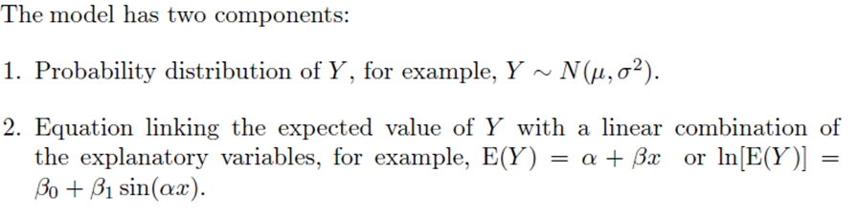
Step 1: Model specification

Slide 10



Model specification
Normal linear models
Multiple linear regression and analysis of variance (ANOVA) are all of this form.

Slide 11
Step 2: Estimation of the parameters of the model
The most commonly used estimation methods are
Least Squares
Maximum Likelihood

Slide 12
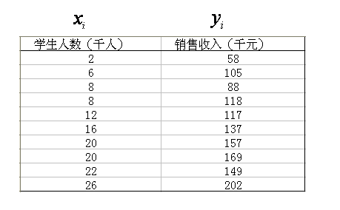
Estimation
Normal linear models
假定由位于大学校园附近的10家Armand比萨饼连锁店组成一个样本。

Slide 13
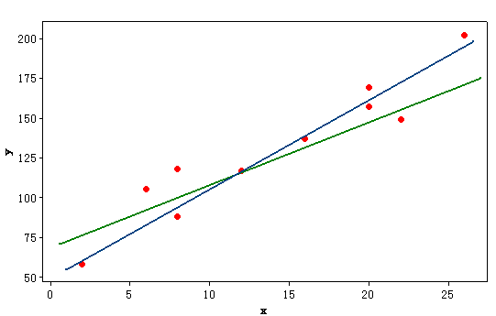

针对具体样本应该选择一条什么直线

Slide 14
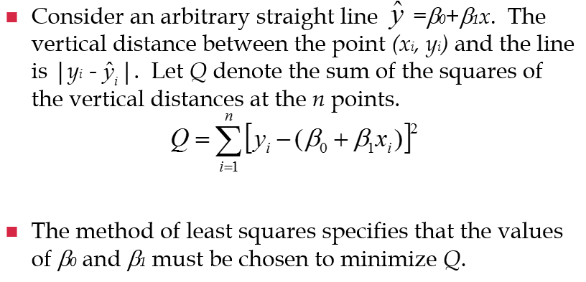
The Least Square Estimation

Slide 16
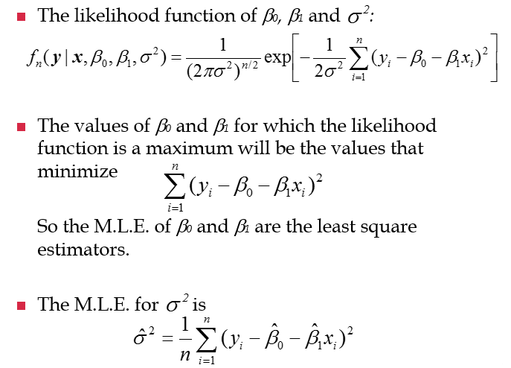
Maximum Likelihood Estimation

Slide 17
Distinction between the least squares and maximum likelihood
Least squares is that the method of least squares can be used without making assumptions about the distributions of the response variables Y_{i} .
In contrast, to obtain maximum likelihood estimators we need to specify the probability distribution of the Yi’s.

Slide 18
Example : Birth weight and gestational age
The data in Table are the birth weights (in grams) and estimated gestational ages (in weeks) of 12 male and female babies born in a certain hospital. The mean ages are almost the same for both sexes but the mean birth weight for boys is higher than the mean birth weight for girls. The data are shown in the scatter plot in Figure. There is a linear trend of birth weight increasing with gestational age and the girls tend to weigh less than the boys of the same gestational age. The question of interest is whether the rate of increase of birth weight with gestational age is the same for boys and girls.

Slide 19
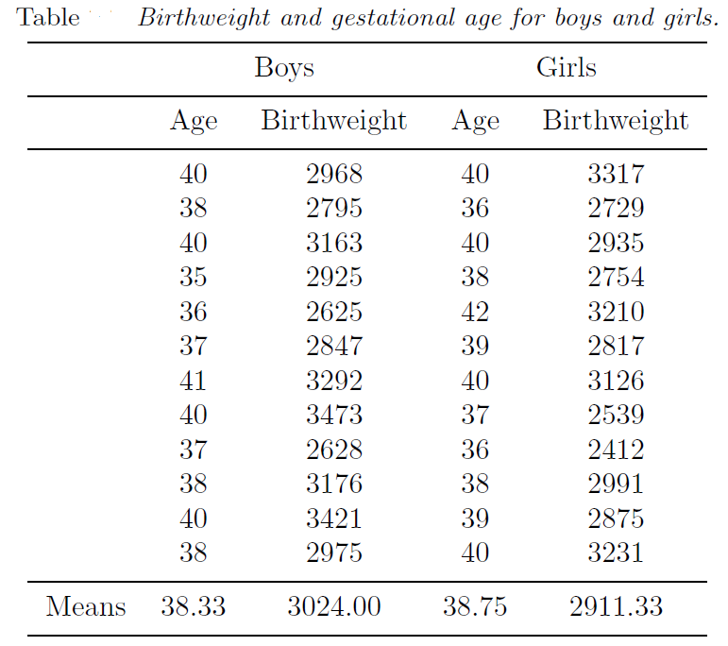

Slide 20
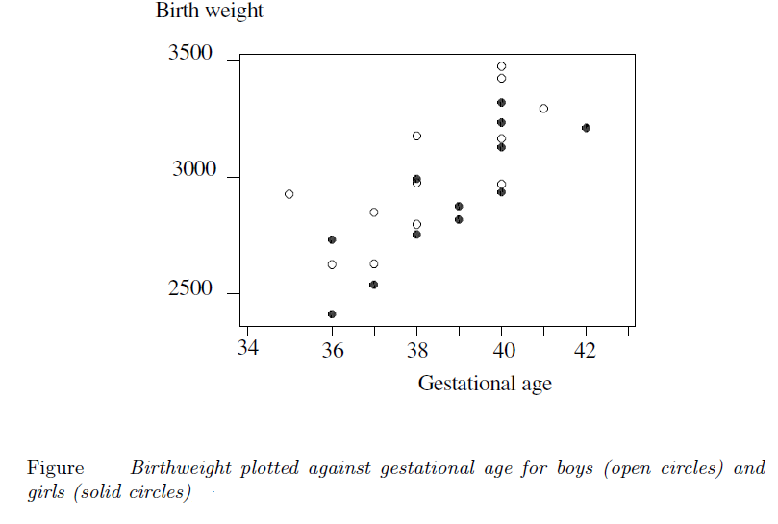

Slide 21
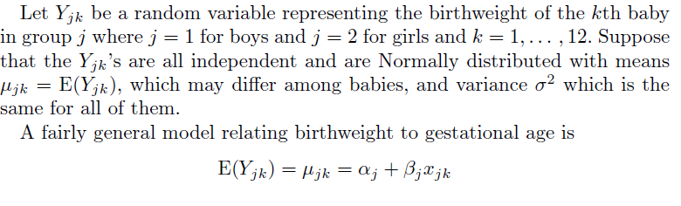
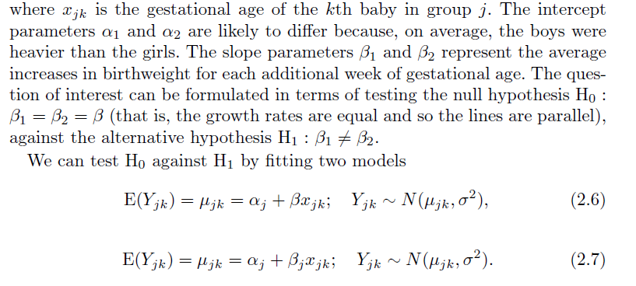

Slide 22
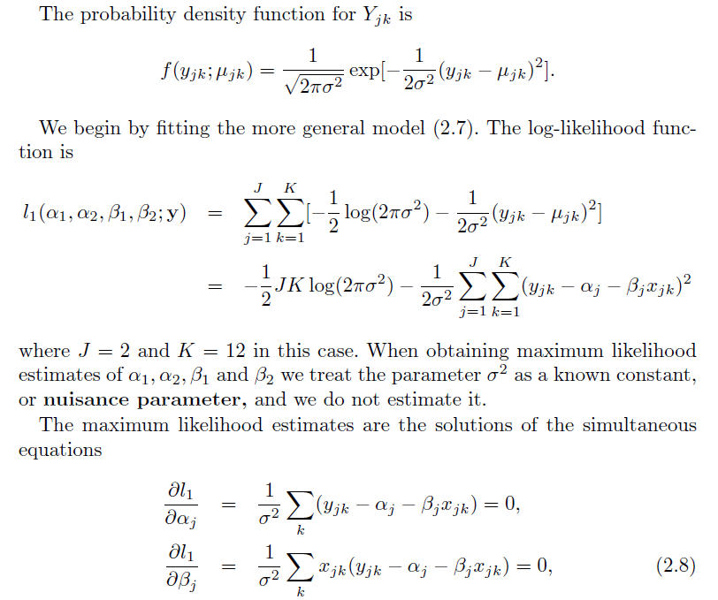

Slide 23
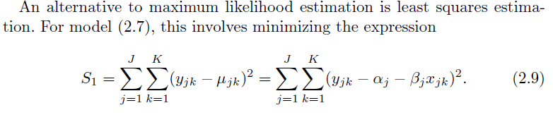
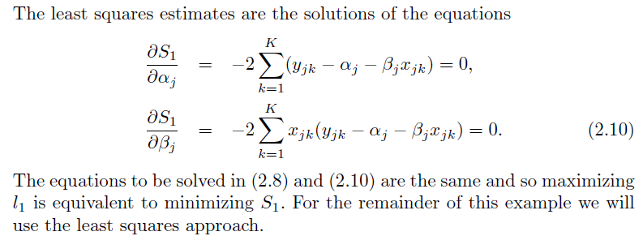

Slide 24
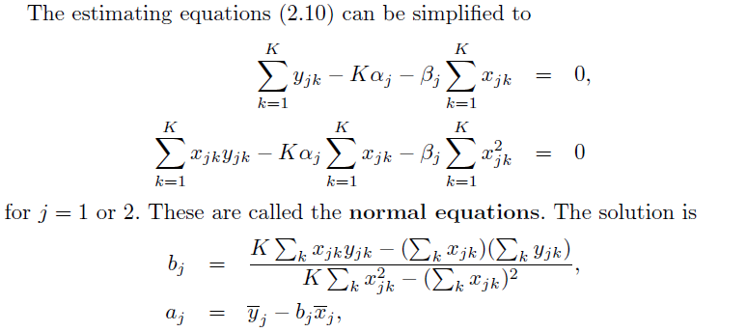
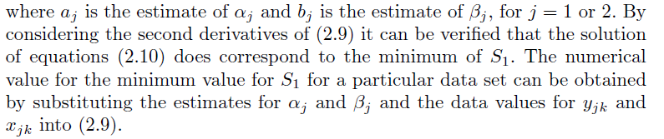

Slide 25
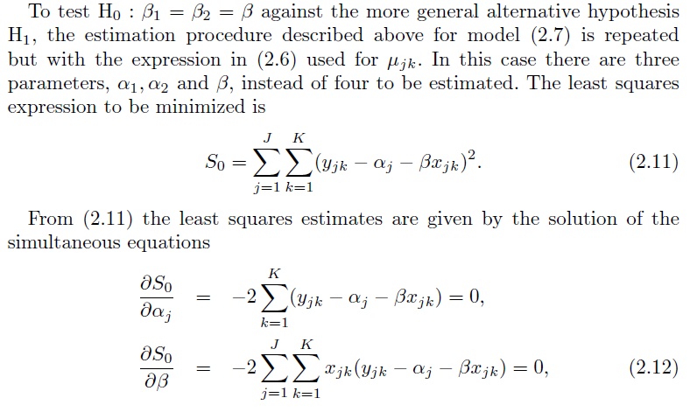

Slide 26
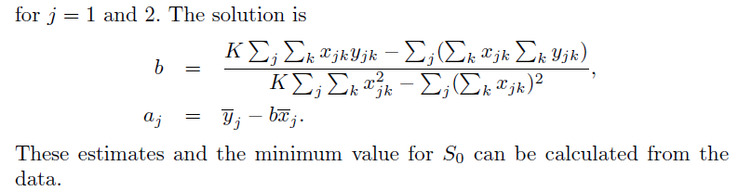

Slide 27
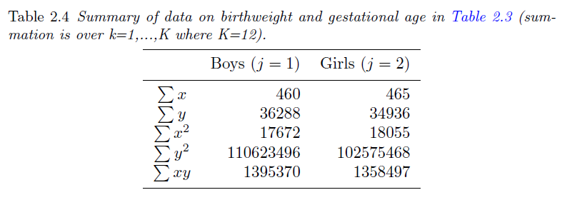
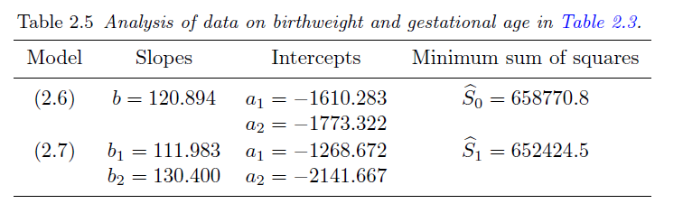

Slide 28
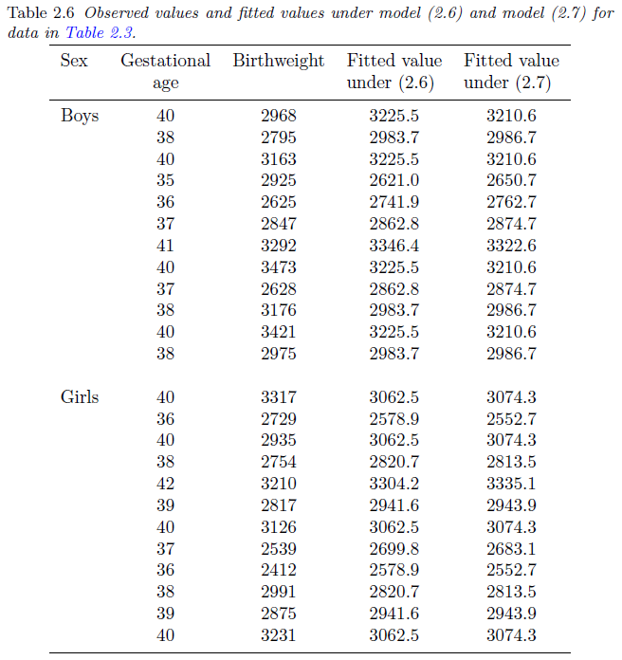

Slide 29
Step 3: Checking the adequacy of the model
Residuals
Measure of goodness of fit
Hypothesis testing of competing models

Slide 30
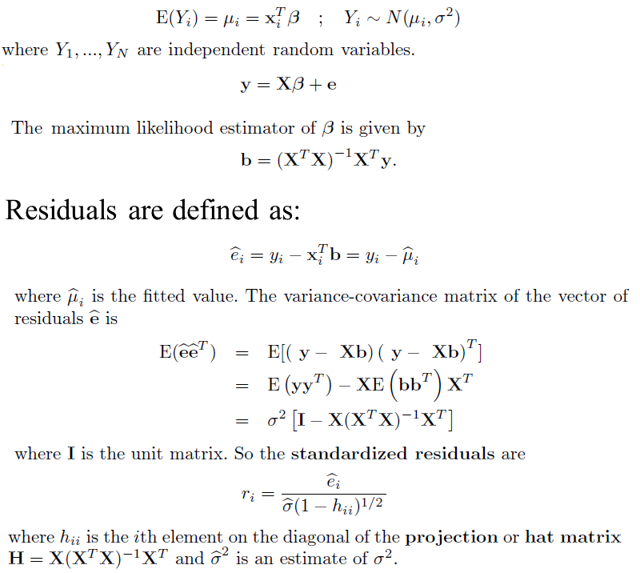
Residuals
Normal linear models

Slide 31
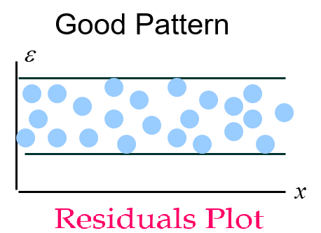
Residuals are important tools for checking the assumptions made in formulating a model.
They should usually be independent and have distribution which is approximately Normal with a mean of zero and constant variance.
The standardized residuals can be compared to the Normal distribution.
No more than 5% should be less than -1.96 or greater than 1.96; and no more than 1% should be beyond -2.58 and 2.58.

Slide 32
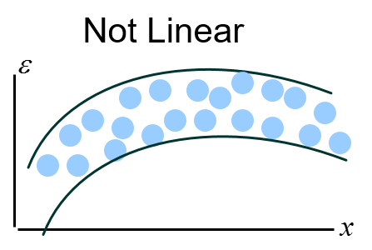
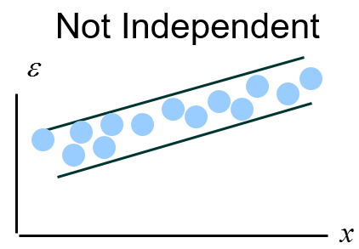
Residuals should be unrelated to the explanatory variables.
The standardized residuals should be plotted against each of the explanatory variables.
If the model adequately describes the effect of the variable, there should be no apparent pattern in the plot. If it is inadequate, the points may display curvature or some other systematic pattern which would suggest that additional or alternative terms may need to be included in the model.
The residuals should also be plotted against other potential explanatory variables that are not in the model. If these is any systematic pattern, this suggests that additional variables should be included.

Slide 33
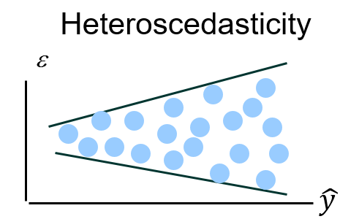
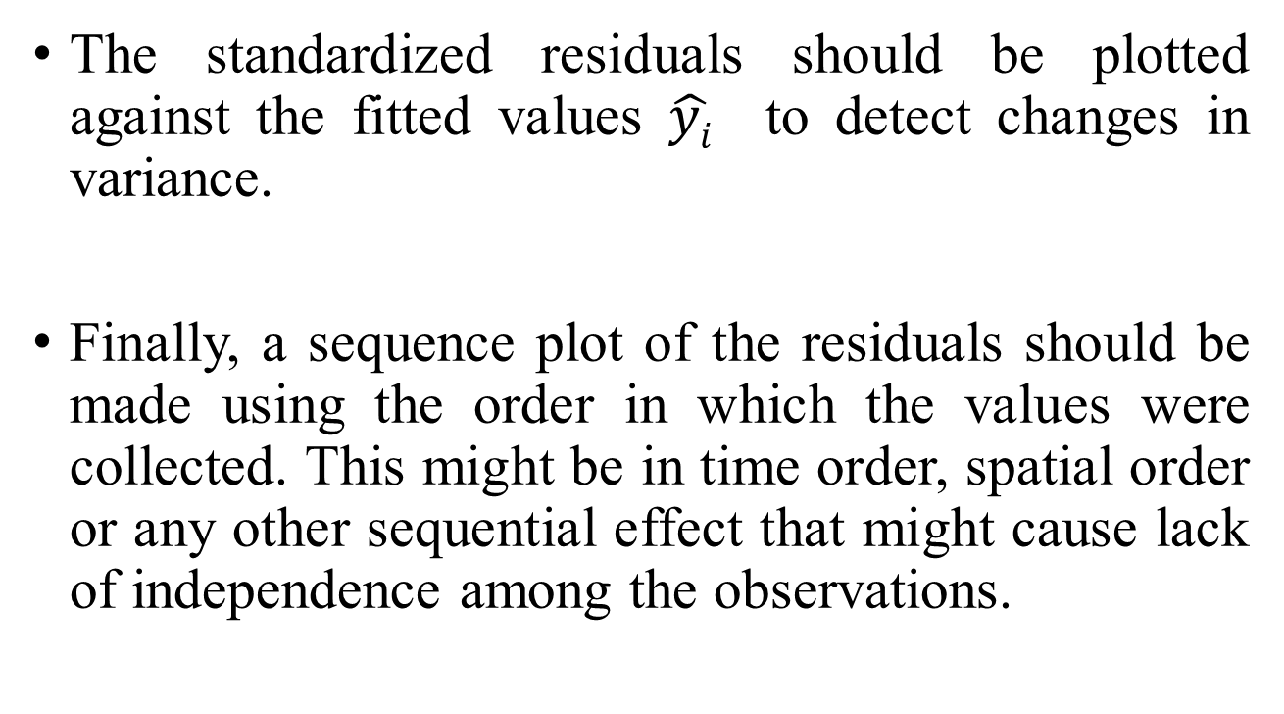
The standardized residuals should be plotted against the fitted values $\hat{yi}$ to detect changes in variance.
Finally, a sequence plot of the residuals should be made using the order in which the values were collected. This might be in time order, spatial order or any other sequential effect that might cause lack of independence among the observations.

Slide 34
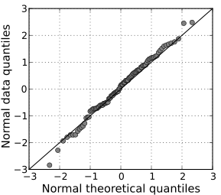
Normality check
In addition to the plots we mentioned before to check the model assumptions, we also need to assess distribution assumption.
We can use a Normal probability plot (Q-Q plot, ("Q" stands for quantile), which is a graphical method for comparing two probability distributions by plotting their quantiles against each other.
In the plot the points should lie on or near a straight line representing Normality and systematic deviations or outlying observations indicate a departure from this distribution.

Slide 35
Other diagnostics
Unusual data are problematic in a linear regression because they can unduly influence the results of the analysis, and because their presence may be a signal that the regression model fails to capture important characteristics of the data.

Slide 36
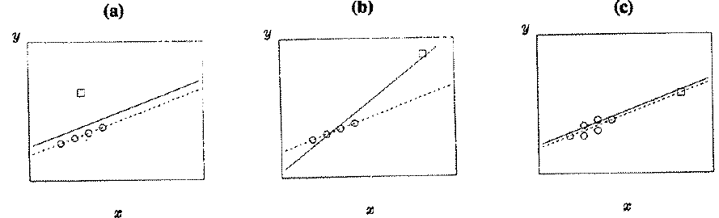
Influential observation
An influential observation is one which has a relatively large effect on inferences based on the model.

Slide 37
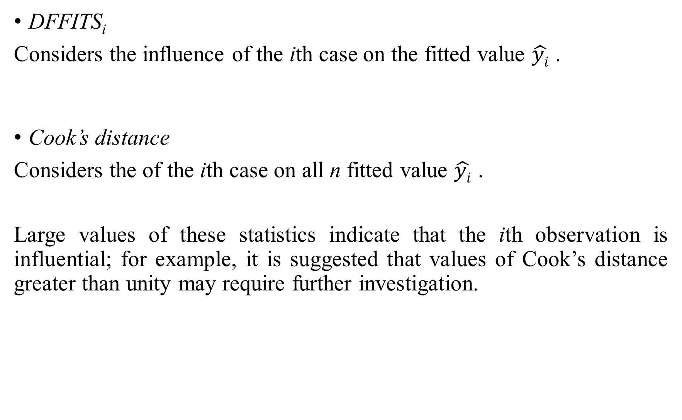
DFFITS_{i}
Considers the influence of the ith case on the fitted value $\hat{yi}$ .
Cook’s distance
Considers the of the ith case on all n fitted value $\hat{yi}$ .
Large values of these statistics indicate that the ith observation is influential; for example, it is suggested that values of Cook’s distance greater than unity may require further investigation.

Slide 38
DFBETA_{i} =b - b(i)
We look at the change in the estimated regression coefficients that would occur if the ith observation was deleted. b(i) denotes the coefficients estimated with the ith row deleted.
DFBETAS_{i} = standardized DFBETA_{i}
dividing DFBETA_{i} by their standard errors, and then they can be compared with the standard Normal distribution to identify unusually large ones. They can be plotted against the observation numbers i so that the “offending” observations can be easily identified.

Slide 39
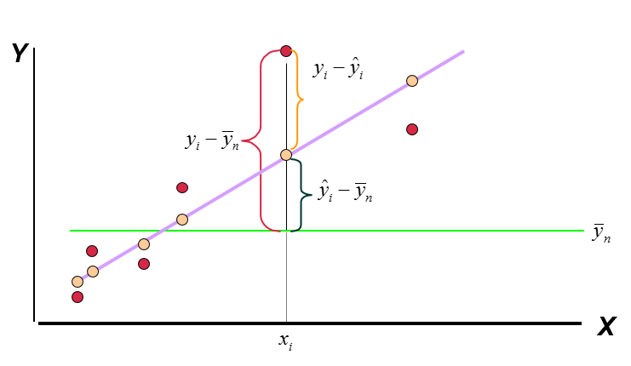
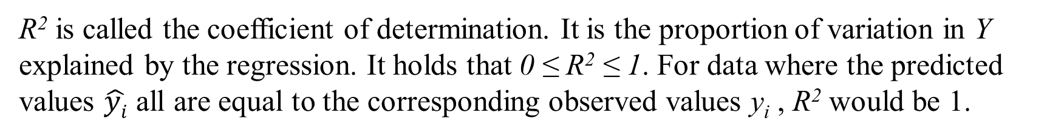
Measure of goodness of fit: R square
R² is called the coefficient of determination. It is the proportion of variation in Y explained by the regression. It holds that 0 ≤ R² ≤ 1. For data where the predicted values $\hat{yi}$ all are equal to the corresponding observed values y_{i} , R² would be 1.

Slide 40

Adjusted R²
When several models have been fitted to the same data, R² can be used to judge which model to prefer. However, since R² increases (or is unchanged) when new terms are added to the model, model comparisons are often based on the adjusted R². The adjusted R² decreases when irrelevant terms are added to the model. It is defined as

Slide 41
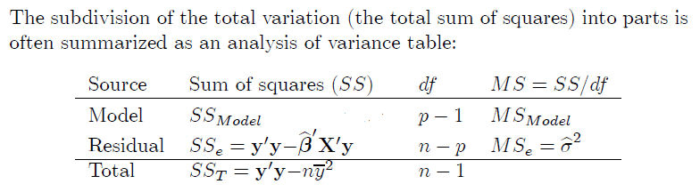
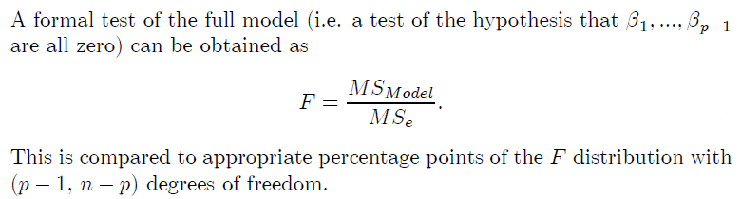
F test

Slide 42
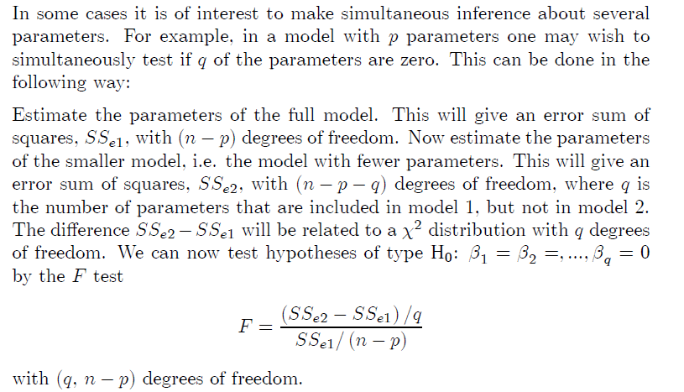
Tests on subsets of the parameters

Slide 43
Collinearity
Many applications of multiple linear regression involve numerous explanatory variables and it is important to identify a subset of these variables that provides a good, yet parsimonious, model for the response.
If some of the explanatory variables are highly correlated with one another, this is called collinearity or multicollinearity.
The columns of the design matrix X may be nearly linearly dependent so that X^{T}X is nearly singular and the estimating equation X^{T}X b = X^{T}y is ill-conditioned. The b’s standard errors are large, reflecting the imprecision of estimation of βs; consequently, confidence intervals for the βs are broad; small changes in the data may cause large charges in b.

Slide 44
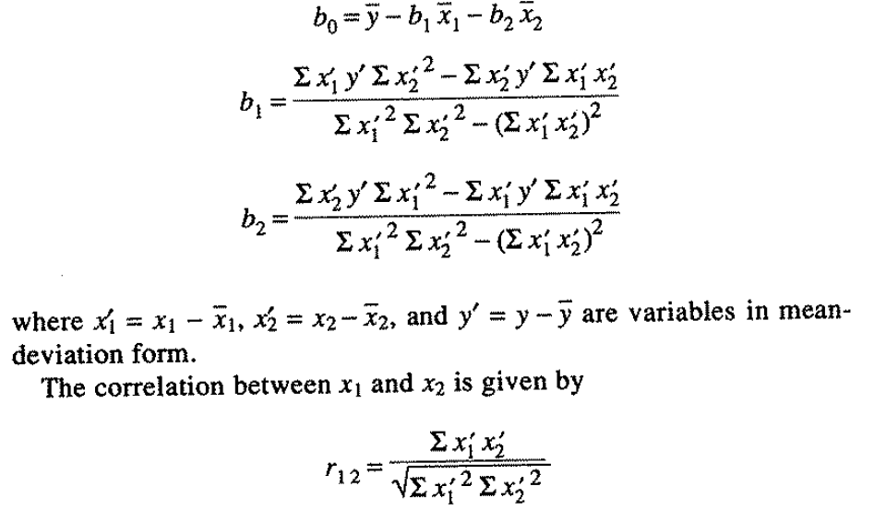
For example, for data with y, X₁ and X₂, we can get the estimates for the linear model:

Slide 45

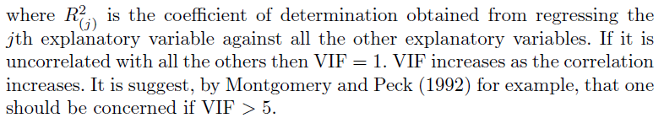
Variance Inflation Factor
Collinearity can be detected by calculating the variance inflation factor for each explanatory variable

Slide 46
Step 4: Inference
When model is fixed, the estimated magnitude of the parameter and the reliability of the estimate as indicated by its standard error or a confidence interval are far more informative than significance levels or p-values. They make it possible to answer questions such as: is the effect estimated with sufficient precision to be useful, or is the effect large enough to be of practical significance?

Slide 47
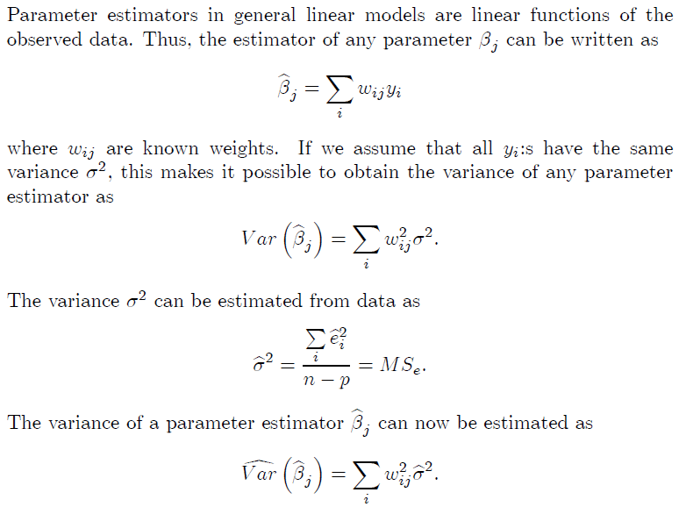
Inference on single parameter
Normal linear models

Slide 48
